Slide 1
Campus Lost & Found Portal: A Java-Based Item Recovery and Management System
SIMATS ENGINEERING Saveetha Institute of Medical and Technical Sciences Chennai-602105
Student Name – B. S. Uday kiran (192311185)
Student Name – Vedvyass M (192324267)
Student Name – P.Sonu (192365057)
Supervisor
Dr. Meganathan E
SIMATS Engineering

Slide 2
Introduction
The Campus Lost & Found Portal is a Java-based application designed to manage lost and found items within a college campus.
Students and staff can report lost items and register items they have found.
The system stores item details such as name, category, location, date, description, and contact information.
Users can search and filter reported items to identify possible matches.
Administrators can verify reports, manage users, and monitor item recovery.
The system reduces the dependency on physical notices, WhatsApp groups, and manual searching.

Slide 3
Problem Statement
Lost items on campus are often reported through informal channels such as WhatsApp groups or notice boards.
There is no centralized system to record and track lost and found belongings.
Students may find it difficult to identify whether their lost item has been recovered.
Manual management can result in duplicate, outdated, or incomplete information.
There is a need for a centralized, searchable, and secure platform to improve the recovery process.

Slide 4
Objectives
To develop a centralized portal for reporting lost and found items.
To allow users to easily register, search, and track items.
To provide item matching based on details such as category, location, date, and description.
To allow administrators to verify and manage submitted reports.
To maintain a database of lost and found items.
To improve the chances of returning lost belongings to their rightful owners.
To reduce manual effort and communication gaps.

Slide 5
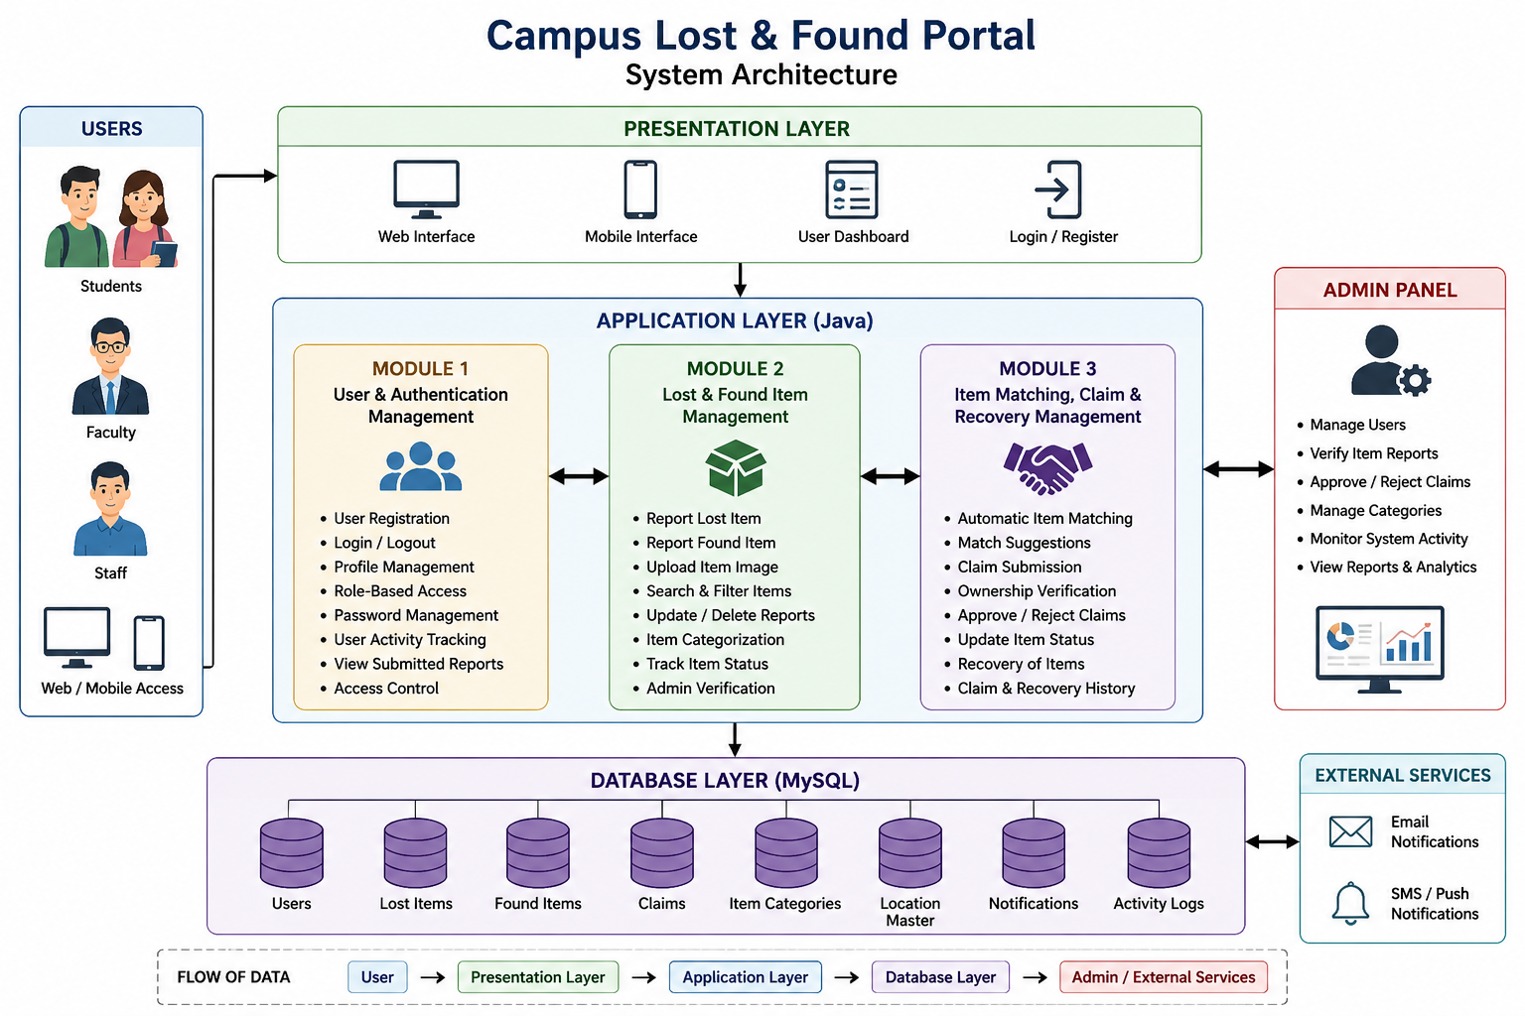
System Architecture / Workflow

Slide 6
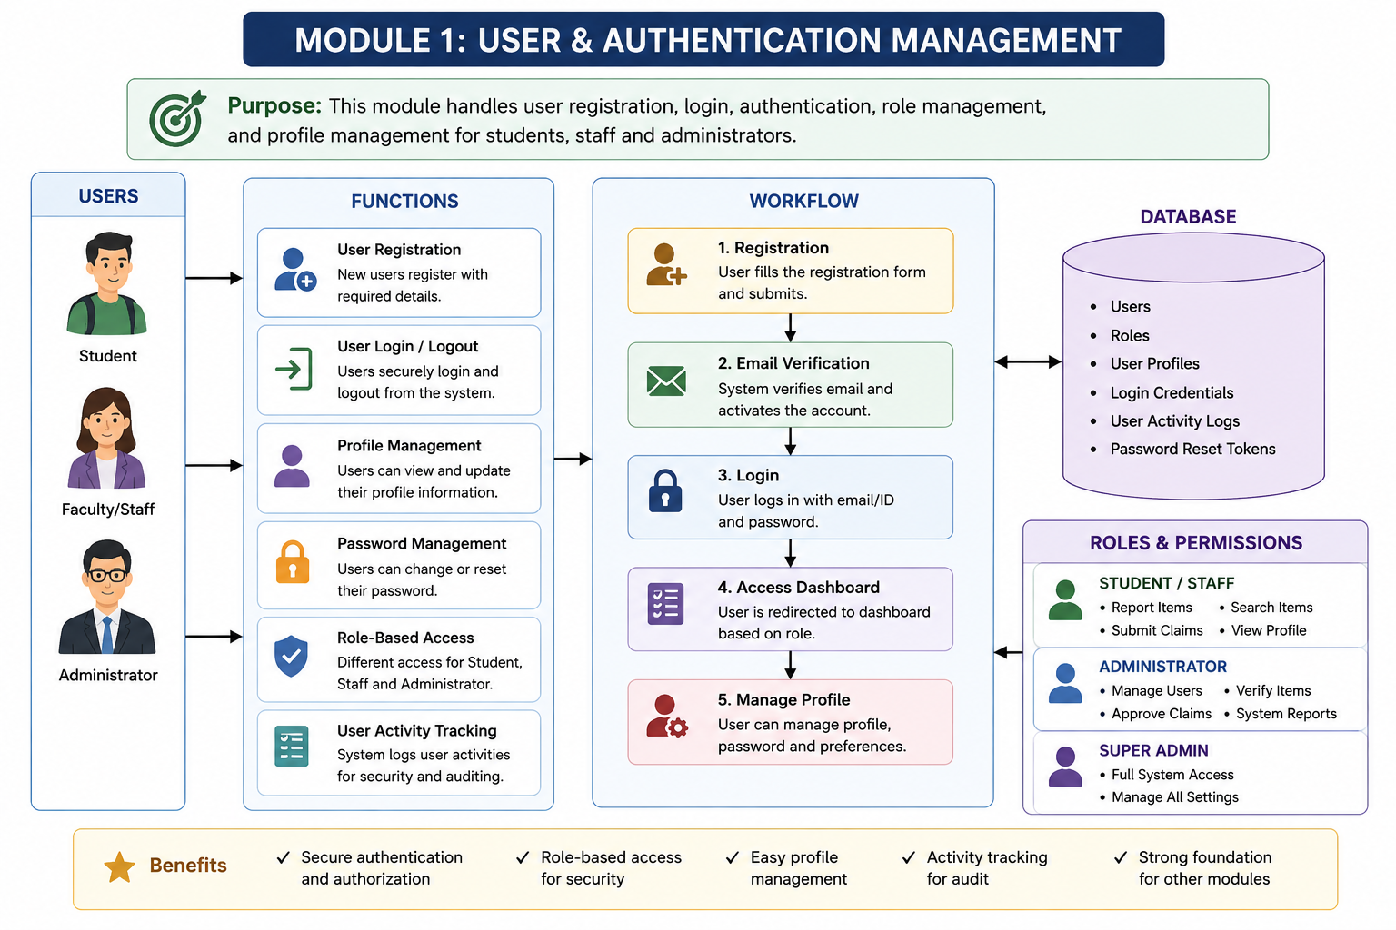
Module 1
User & Authentication Management:
Allows students, faculty, and staff to register on the Lost & Found Portal.
Provides secure login and logout functionality.
Stores user details such as name, ID, email, department, and contact information.
Provides role-based access for users and administrators.
Allows users to view and update their profiles.
Provides password management and basic authentication security.
Allows users to view and manage their previously submitted reports.
Prevents unauthorized users from accessing restricted system functions.

Slide 7
Module 1
User & Authentication Management:
Register → User chooses to create a new account.
Registration Form → User enters name, ID, email, password, department, and contact details.
Java Servlet → Receives the registration data from the form.
Validate Details → Java checks whether the entered information is correct and complete.
JDBC → Connects the Java application to the MySQL database.
MySQL → users table → Valid user details are stored in the users table.
Register
↓
Registration Form
↓
Java Servlet
↓
Validate Details
↓
JDBC
↓
MySQL → users table

Slide 8
Module 1
Techinique used :
JDBC Connector - Direct connection to H2 database using `DriverManager.getConnection()`\
1. Variables and Data Types :
private static final String URL = "jdbc:h2:file:./data/lostfound;...";
private static final String USER = "sa";
private int claimId; // int type
private String status; // String type
private ArrayList<Claim> claims; // Reference type
Declares different data types: `String`, `int`, `boolean``final` keyword for constants that cannot be changed `static` keyword for class-level variables shared across all instances
2. Exception Handling (Try-Catch)
try (Connection conn = DatabaseConfig.getConnection();
PreparedStatement stmt = conn.prepareStatement(sql)) {
// Database operations
} catch (SQLException e) {
e.printStackTrace();
return false;
}

Slide 9
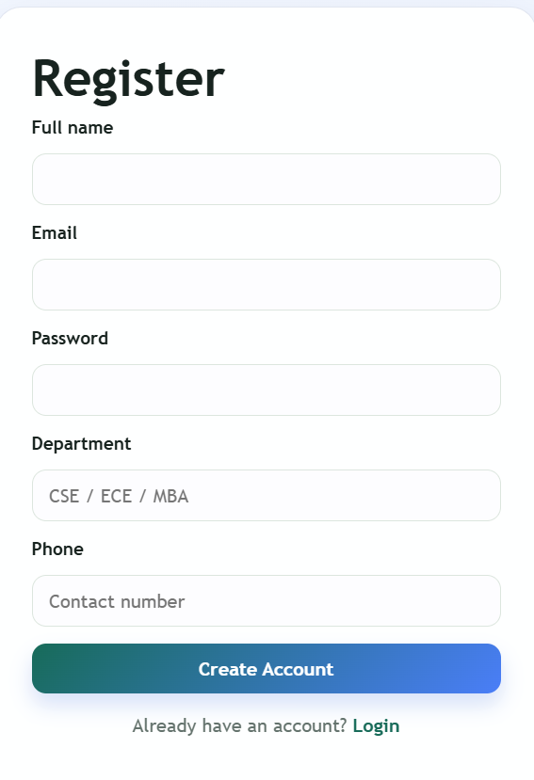
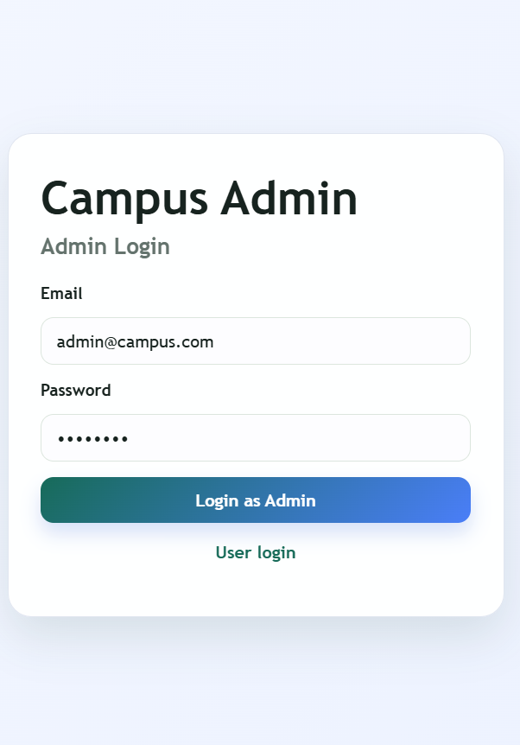
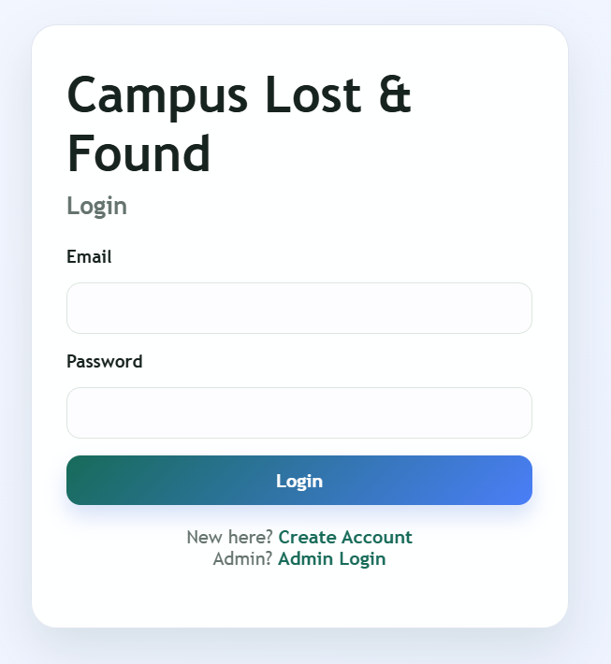
OUTPUT

Slide 10
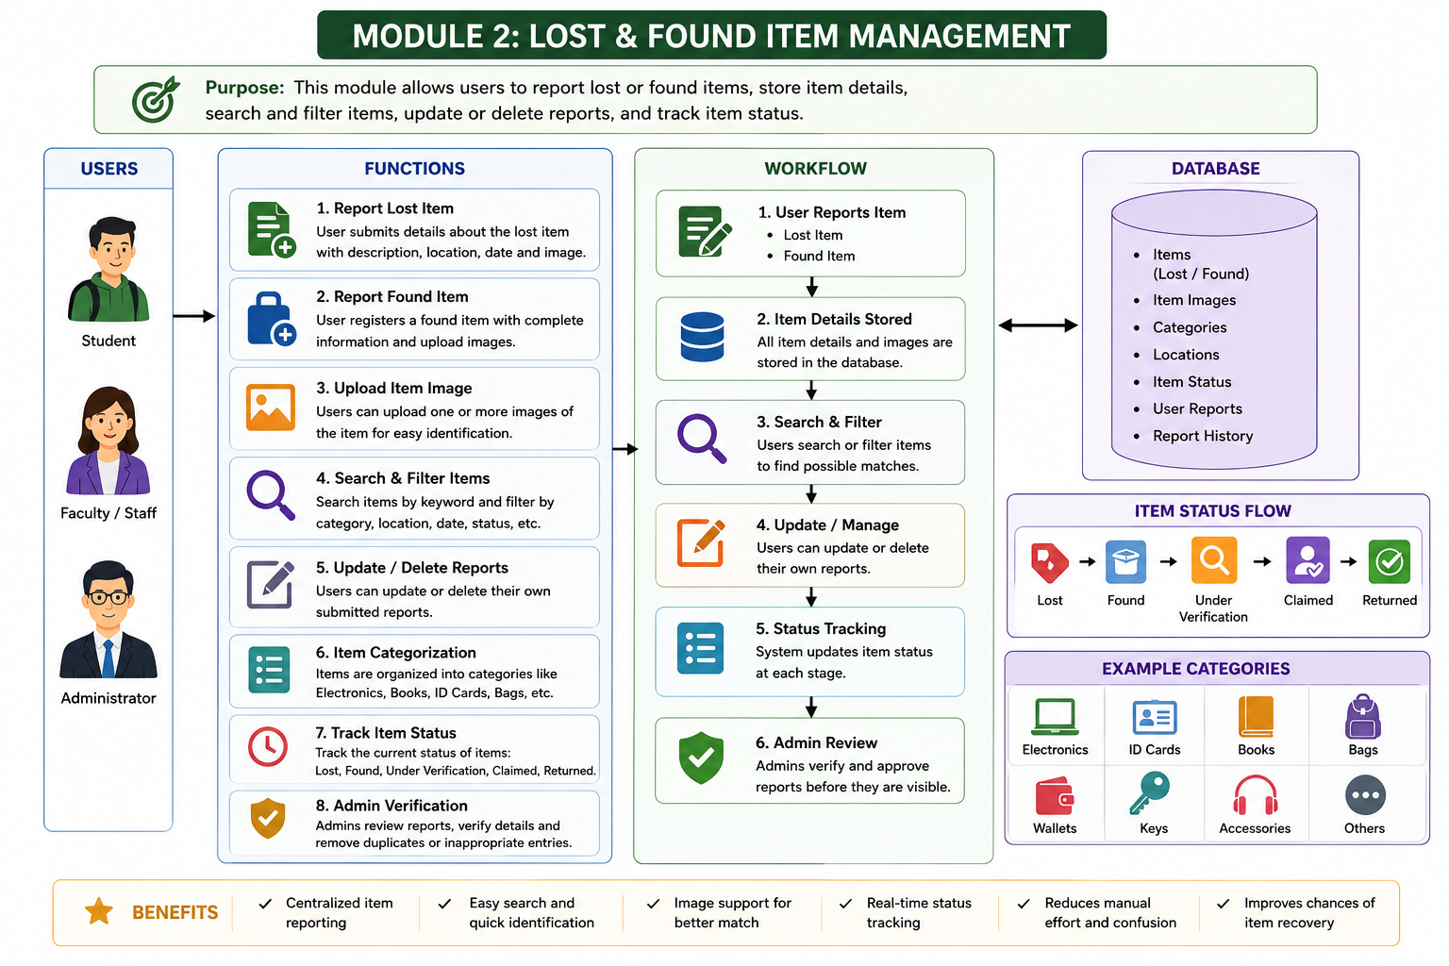
Module 2
Lost & Found Item Management:
Allows users to report lost items by entering complete item details.
Allows users to register found items discovered anywhere on campus.
Stores details such as item name, category, color, description, date, and location.
Supports image uploading to make item identification easier.
Provides search and filter options based on category, location, date, and keywords.
Allows users to update or delete their submitted item reports.
Maintains item statuses such as Lost, Found, Claimed, and Returned.
Allows administrators to review, verify, and manage reported items.

Slide 11
Module 2
Lost & Found Item Management:
Image Upload → Saves an item image so users and administrators can identify it easily.
Search & Filter → Allows users to find items using category, location, date, or keywords.
Update / Delete Report → Allows users to modify or remove their own submitted reports.
Item Status Management → Maintains statuses such as Lost, Found, Claimed, and Returned.
Admin Review & Verification → Allows administrators to verify reports and manage inappropriate or incorrect listings.
MySQL → items table
↓
Image Upload
↓
Search & Filter
↓
Update / Delete Report
↓
Item Status Management
↓
Admin Review & Verification

Slide 12
Module 2
Techinique used :
Packages - Organized code structure (`com.lostfound.*`)
Inheritance - Servlets extending `HttpServlet` class.
1. Object Creation using Constructor
User user = new User(name, email, password, department, phone, "USER");
// Constructor with parameters
public class User {
public User() {} // No-argument constructor
public User(String name, String email, String password, ...) {
this.name = name;
this.email = email;
// Initialize all fields
}
}

Slide 13
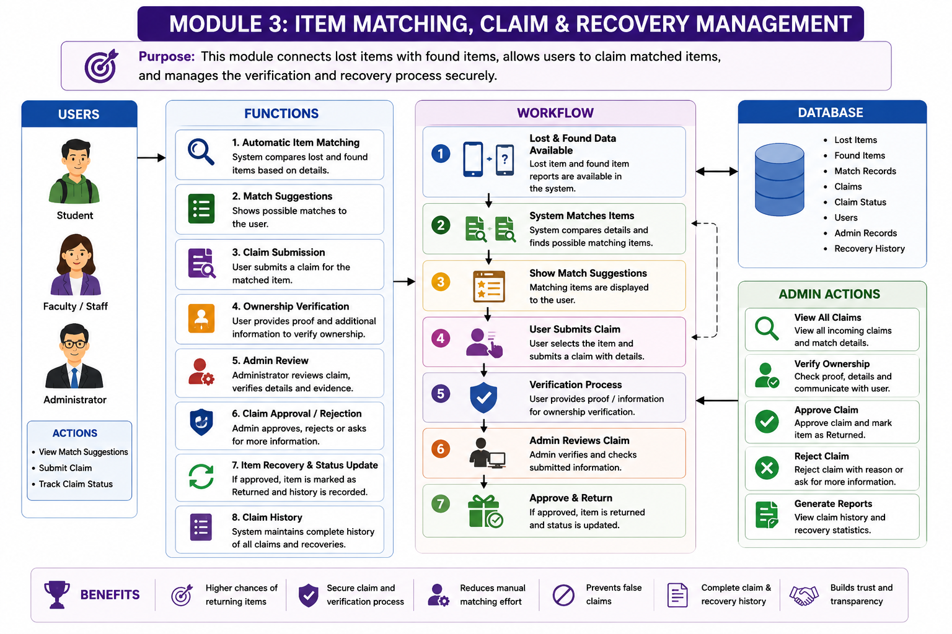
Module 3
Item Matching, Claim & Recovery Management:
Compares lost and found item details to identify potential matches.
Matches items using information such as category, name, color, location, and description.
Displays possible matching items to users.
Allows users to submit a claim request for a matching found item.
Collects additional information from the claimant for ownership verification.
Allows administrators to review and approve or reject claim requests.
Updates the item status after successful verification and recovery.
Maintains a claim and recovery history for tracking completed transactions.

Slide 14
Module 3
Techinique used :
Collection Framework (List)** - `List<Claim>` and `ArrayList<Claim>` for storing multiple claims
Variable Declaration and Initialization:
List<Claim> claims = new ArrayList<>(); // Declare and initialize
int claimId = Integer.parseInt(request.getParameter("claimId")); // Convert to int
String decision = "APPROVED".equalsIgnoreCase(request.getParameter("decision")) ? "APPROVED" : "REJECTED";
- Variable declaration: `Type variableName;`
- Initialization: `variableName = new Type();`
- Ternary operator: `condition ? valueIfTrue : valueIfFalse`
- Type conversion: `Integer.parseInt()` converts String to int

Slide 15
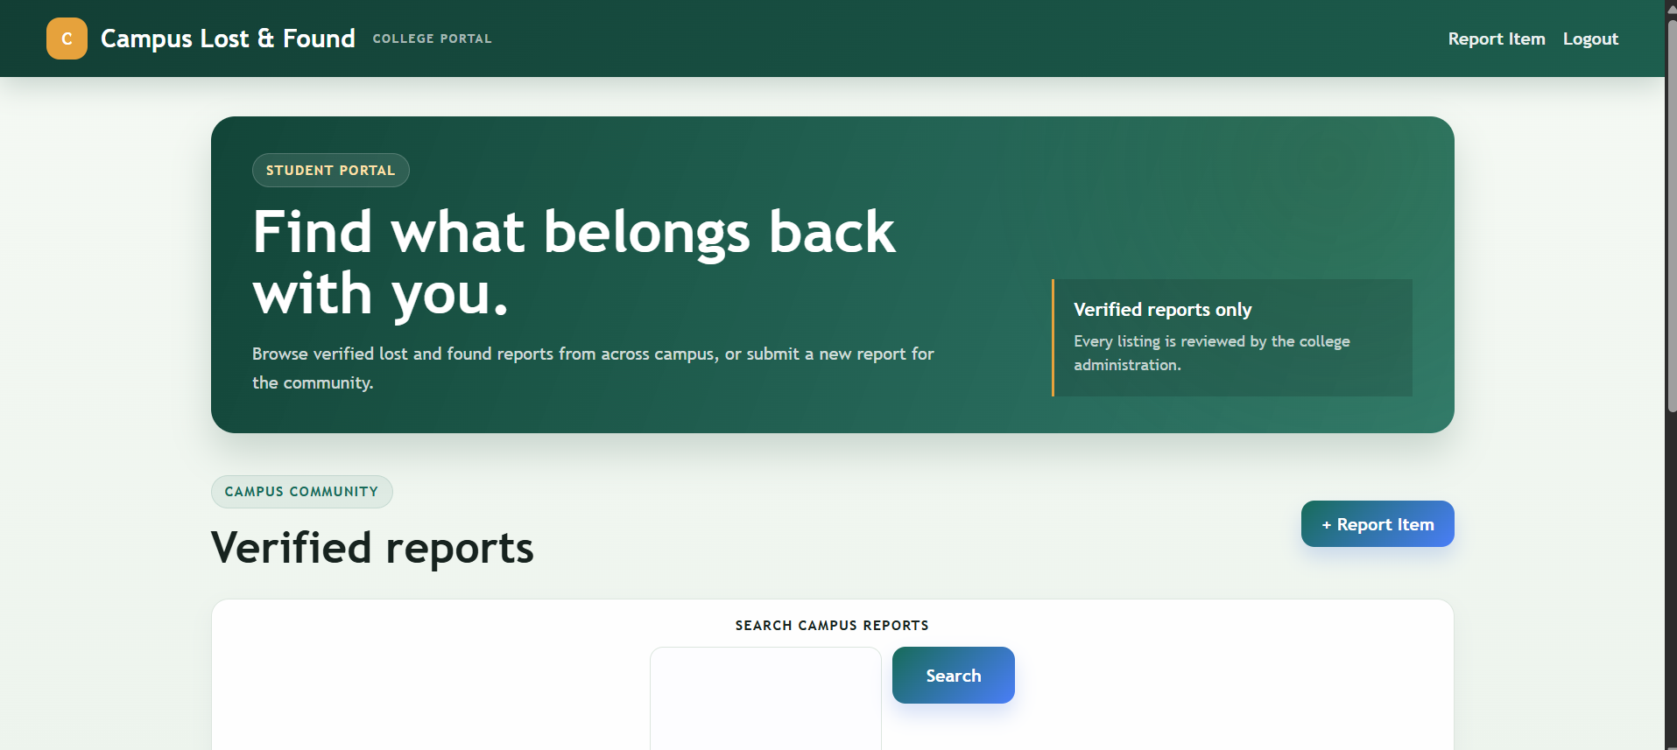
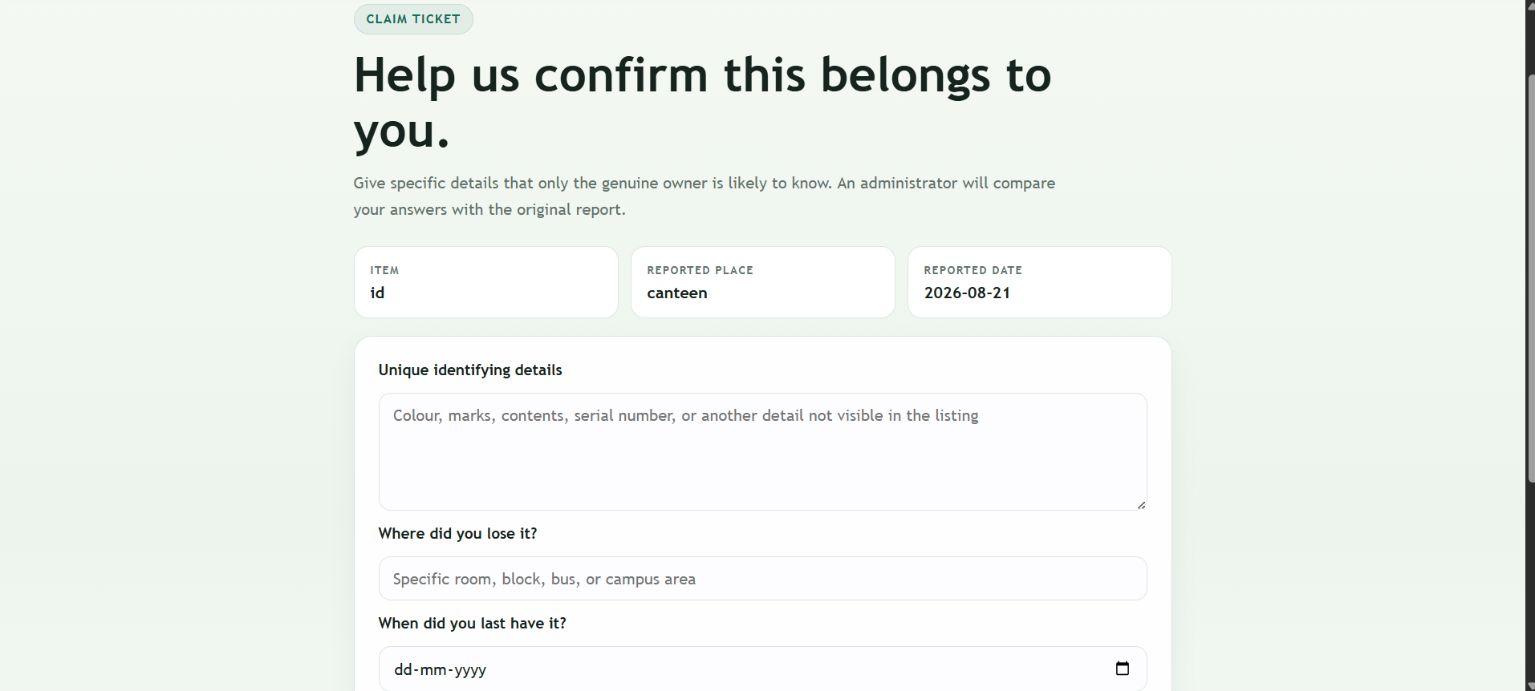
OUTPUT

Slide 16
Conclusion
The Campus Lost & Found Portal provides a centralized solution for managing lost and found belongings.
It makes reporting and searching for items faster and easier.
The matching and claim system improves the possibility of returning items to their rightful owners.
Java provides a suitable platform for implementing the application's business logic and database connectivity.
The system can be further enhanced with AI, mobile applications, notifications, and cloud technologies.
Overall, the project helps create a more organized, efficient, and reliable campus item recovery system.

Slide 17
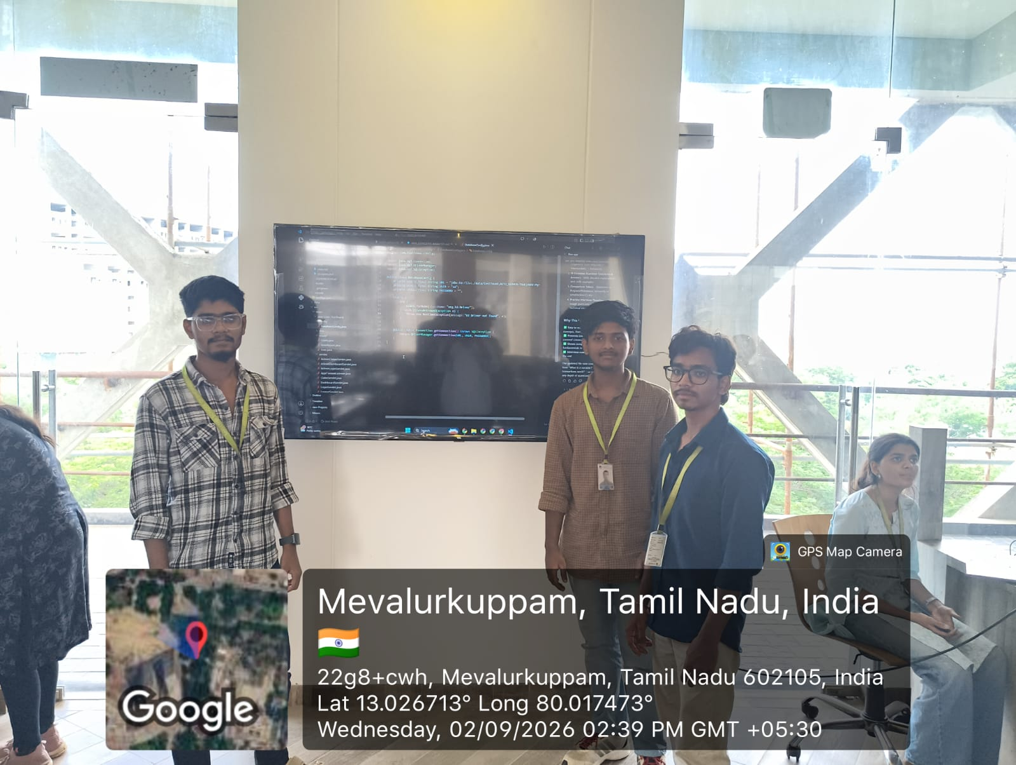


Slide 18
THANK YOU

